Slide 1



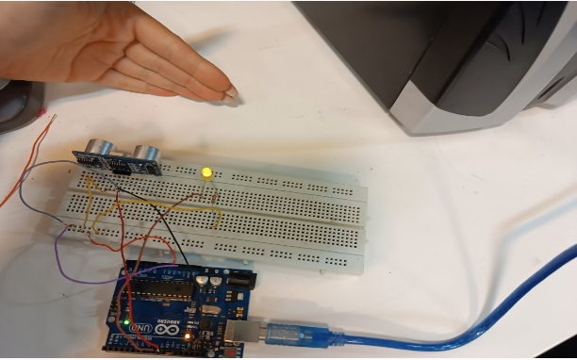

Ultraconic distance measurement
OFF
HIGH

